Slide 1
Spotify – Support Information
MMAI 801 – Introduction to Management
Breakout Room Exercise
Gary J. Bissonette

Slide 2

Spotify's revenue worldwide from 2013 to 2018 (in million euros)
Spotify revenue 2013-2018
Note: Worldwide; 2013 to 2018
Further information regarding this statistic can be found on page 8.
Source(s): Spotify; ID 813713
2

Slide 3
Revenue of Spotify worldwide from 1st quarter 2016 to 4th quarter 2018, by segment (in million euros)
Spotify's quarterly revenue 2016-2018, by segment
Note: Worldwide; Q1 2016 to Q4 2018
Further information regarding this statistic can be found on page 8.
Source(s): Spotify; ID 813835
2

Slide 4
Share of Spotify's cost of revenue from 2011 to 2018
Spotify: cost of revenue share 2011-2018
Note: Worldwide; 2011 to 2018
Further information regarding this statistic can be found on page 8.
Source(s): Spotify; Statista; ID 370618
2

Slide 5
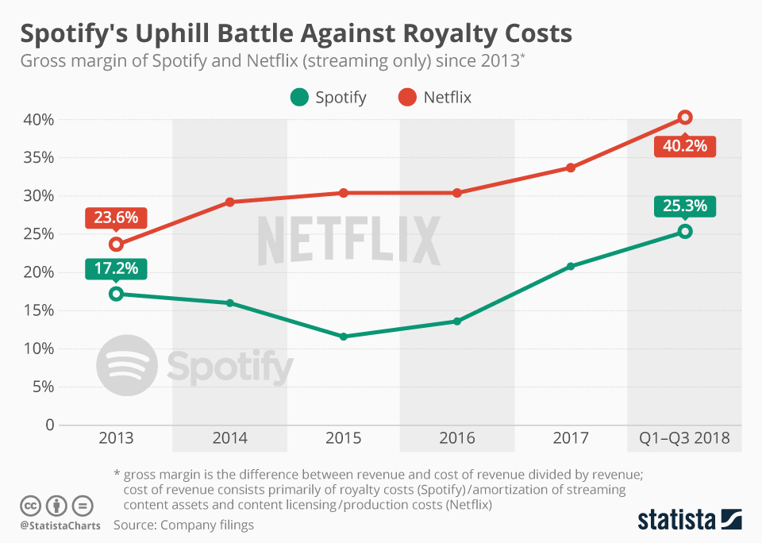

Slide 6
Research and development costs of Spotify worldwide from 2013 to 2018 (in million euros)
Spotify's R&D costs 2013-2018
Note: Worldwide; 2013 to 2018
Further information regarding this statistic can be found on page 8.
Source(s): Spotify; ID 813751
2

Slide 7
Sales and marketing costs of Spotify worldwide from 2013 to 2018 (in million euros)
Spotify's sales and marketing costs 2013-2018
Note: Worldwide; 2013 to 2018
Further information regarding this statistic can be found on page 8.
Source(s): Spotify; ID 813757
2

Slide 8
Operating income of Spotify worldwide from 2013 to 2018 (in million euros)
Spotify's operating income 2013-2018
Note: Worldwide; 2013 to 2018
Further information regarding this statistic can be found on page 8.
Source(s): Spotify; ID 813758
2

Slide 9
Number of Spotify monthly active users (MAUs) worldwide from 1st quarter 2015 to 4th quarter 2018 (in millions)
Spotify's monthly active users 2015-2018
Note: Worldwide; 2015 to 2018
Further information regarding this statistic can be found on page 8.
Source(s): Spotify; ID 367739
2

Slide 10
Number of Spotify ad-supported monthly active users (MAUs) worldwide from 1st quarter 2015 to 4th quarter 2018 (in millions)
Spotify's ad-supported monthly active users 2015-2018
Note: Worldwide; Q1 2015 to Q4 2018
Further information regarding this statistic can be found on page 8.
Source(s): Spotify; ID 813787
2

Slide 11
Number of Spotify premium subscribers worldwide from 1st quarter 2015 to 4th quarter 2018 (in millions)
Spotify's premium subscribers 2015-2018
Note: Worldwide; Q1 2015 to Q4 2018
Further information regarding this statistic can be found on page 8.
Source(s): Spotify; Music Business Worldwide; ID 244995
2

Slide 12
Share of Spotify`s monthly active users worldwide in 2018, by region
Spotify's share of monthly active users 2018, by region
Note: Worldwide; December 31, 2017 to December 31, 2018
Further information regarding this statistic can be found on page 8.
Source(s): Spotify; ID 813902
2

Slide 13
Spotify`s premium average revenue per user (ARPU) worldwide from 2015 to 2017 (in U.S. dollars)
Spotify's premium ARPU 2015-2017
Note: Worldwide; 2015 to 2017
Further information regarding this statistic can be found on page 8.
Source(s): Spotify; ID 813789
2
Average Revenue per User (ARPU) in Q3 2018 was 4.73

Slide 14
EBITDA of Spotify worldwide from 2013 to 2018 (in million euros)
Spotify's EBITDA 2013-2018
Note: Worldwide; 2013 to 2018
Further information regarding this statistic can be found on page 8.
Source(s): Spotify; ID 813765
2

Slide 15
Number of Apple Music subscribers worldwide from October 2015 to November 2018 (in millions)
Number of Apple Music subscribers worldwide 2015-2018
Note: Worldwide; October 2015 to November 2018
Further information regarding this statistic can be found on page 8.
Source(s): Apple; Music Business Worldwide; ID 604959
2

Slide 16
Share of Spotify users in the United States from 2013 to 2018, by frequency
Share of Spotify users in the U.S. 2013-2018
Note: United States; January to February 2018; 12 years and older; 2017: n = 2,000
Further information regarding this statistic can be found on page 8.
Source(s): Edison Research; Nielsen Audio; Triton Digital; ID 294640
2

Slide 17
Historical Statistical & Financial Data
Spotify Technology S.A.

Slide 18
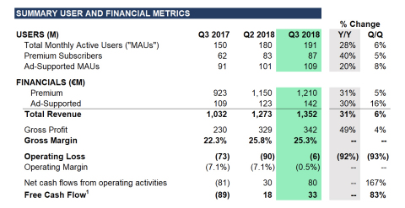
Spotify – Q3 Reported Statistical & Financial Data

Slide 19
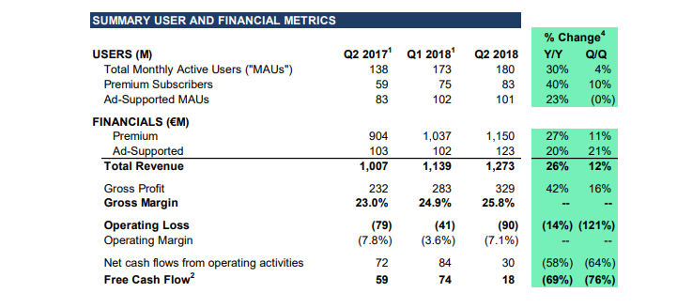
Spotify – Q2 Reported Statistical & Financial Data

Slide 20
Spotify.com
Additional Pertinent Information
Spotify initiated a direct IPO in April 2018. Current share value is $156.60 (USD). Current “market cap” is estimated at $27.89B (USD). Share price 52 week high was $171.23 (USD). 52 week low was $135.51 (USD). Share price is currently $189.21 (August 31, 2018).
In 2015, Spotify sold private equity at a valuation of $8.5 billion (USD).
The company issued $1 billion (USD): in convertible debt in first quarter 2016. Specifics associated with this debt issuance are as follows:
Conversion of debt to equity shares, following the IPO, is at a 20% discount
The interest rate on the debt accelerates from 5% to 10%, with the rate increasing by 1% for each six-month period that the IPO is delayed.
Spotify has yet to make a profit in each of the last 10 years of operation.
In 2015, Spotify had an annual average of 18 million customers paying approximately 106 Euros per year for its premium service.
Spotify estimates that it has between 90 and 100 million subscribers in total (2016). Its active user base is estimated at estimated at 80 million, with an average desertion rate (inactivity) of 50%.
Spotify delivered 3 billion playlist streams in 2015, with a library of over one million songs. The company has indicated that the future is in videos and will be looking to add this to its product portfolio.
Euros to US Dollar conversion rate, at the time of preparation was approximately 1 Euro to $.87 USD

Slide 21


Leading online radio companies in the United States in August 2018, by average active sessions
Leading online radio companies in the U.S. 2018, by active sessions
Note: United States; August 2018; from 6:00 am to 8:00 pm, Monday through Friday
Further information regarding this statistic can be found on page 8.
Source(s): Triton Digital; ID 253260
2

Slide 22
Share of Spotify users in the United States as of March 2018, by age
Spotify users in the U.S. 2018, by age
Note: United States; March 2018
Further information regarding this statistic can be found on page 8.
Source(s): Verto Analytics; ID 475821
2

Slide 23
Spotify's sales and marketing costs 2013-2017
Sales and marketing costs of Spotify worldwide from 2013 to 2017 (in million euros)
Note: Worldwide; 2013 to 2017
Further information regarding this statistic can be found on page 8.
Source: Spotify ID 813757

Slide 24
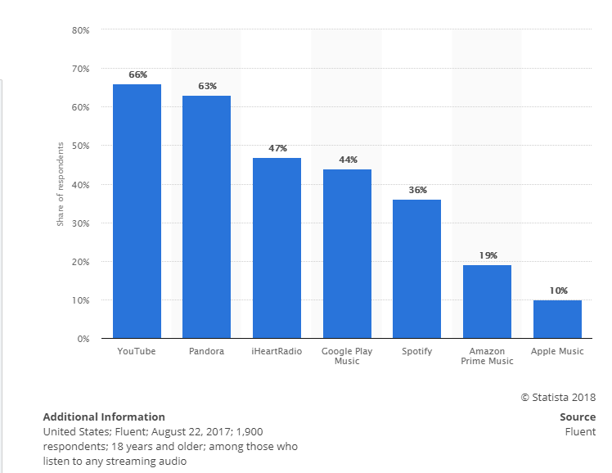
Spotify.com
Most Popular Streaming Services in U.S.A. - 2017

Slide 25
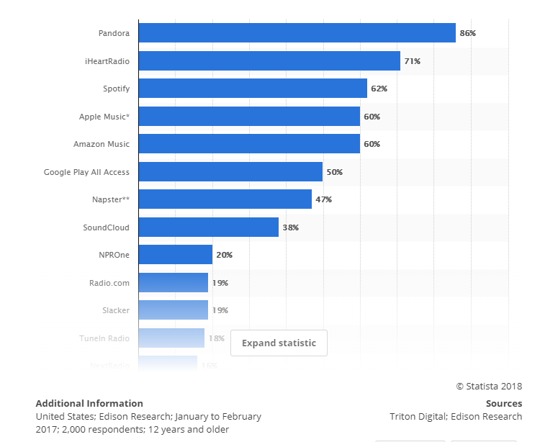
Spotify.com
Awareness Rate of Music Services in U.S.A. - 2017

